Slide 1
dSoftArk
Software Architecture
Programming in the Large
AU CS
Henrik Bærbak Christensen

Slide 2
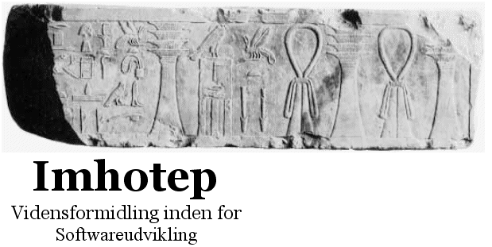
The lecturer
Henrik Bærbak Christensen
Associate professor (lektor) since 2003
  Software developer/architect in industry, 91-94
  Collaboration with many Danish IT companies
    Systematic, Jyske Bank, Terma, B&O, KMD, Danfoss, …
Faglig koordinator for Master og Diplom (SWK)
Owner of
    Course development
    and consultancy
    http://www.imhotep.dk
AU CS
Henrik Bærbak Christensen

Slide 3
Topics
Software Architecture
  primarily from the operational point of view
    that is: help me to write flexible, reliable, code!
  but also from a reflective/academic point of view
    terminology, analysis, choosing the best solution
Quality focus: Flexible and Reliable
  design patterns, frameworks, compositional design,…
    Making software flexible
  test-driven development, testing, tool support, …
    Making software reliable
AU CS
Henrik Bærbak Christensen

Slide 4
Course focus
Focus is on:
Operational level
  use technique X to produce reliable, flexible, software
and next the reflective/academic level
  use the proper terminology
  discuss technique X and relate it to technique Y, Z…
  understand benefits and liabilities of technique X
AU CS
Henrik Bærbak Christensen

Slide 5
Relations to other courses
This course elaborates and adds to material presented earlier:
  dIntProg: Object-oriented design, UML
  dProg2: Design patterns, frameworks…
Main challenges here:
  process and testing
  combine and apply – digging deeper
  evaluate, reflect,
AU CS
Henrik Bærbak Christensen

Slide 6
Scientific Foundation
The course is anchored in an empirical tradition.
Computer Science - Software Engineering
Results arise from:
  practice and experience
  reflection over practice
  logical argumentation and analysis
That is:
  No proofs nor QEDs
    which is not natural science anyway ☺
  No ultimate truths – it is generally “best practice”
    Some good solutions – and a lot of really bad ones…
  But – terminology, concepts, analysis !
AU CS
Henrik Bærbak Christensen

Slide 7
Notes
This is a contact-sport!
  You learn by doing it.
It is like chess or playing the piano
  the rules are easy to learn (lectures)
  but the game is difficult to master (doing it)
AU CS
Henrik Bærbak Christensen

Slide 8
Why is this interesting?
Why should you invest energy in this course?
  because otherwise you will not pass the exam ☺
  because it is vital knowledge if you believe you are
    going to make a thesis with some software development involved
    going to industry to become a
      programmer (even in the face of out-sourcing)
      architect/designer/project manager
      start-up company in software related issues
      millionaire (because you make better designs than others!)
        no guaranties however ☺
AU CS
Henrik Bærbak Christensen

Slide 9
Process
Lectures
  talking about the subject, hopefully discussing…
Two 2 hour slots
  3 hour lectures (Thu + Mon)
  1 hour “reflection” (curriculum free!) (Mon)
    presenting mandatory delivery
    tool presentations
    discussing proposals to exercises
    open for your proposals ☺
AU CS
Henrik Bærbak Christensen

Slide 10
Process
Doing it:
  Exercises: TØ = Lab/Workshops with TA
    Group’s responsibility to be well prepared !
    Workshop: Group work + common discussions
      TA act as discussion leader + consultant
  Mandatory exercises:
    Hand-in: Dates are show in CourseAdmin system
    PDF report + Zip with code delivered using CourseAdmin
Theory
Names are
R.pdf
C.zip
Reflection
Programming
AU CS
Henrik Bærbak Christensen

Slide 11
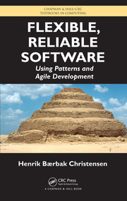
Literature
Primary literature
  Flexible, Reliable Software (FRS)
  Comments still welcome!
  Check the errata on:
    www.baerbak.com
Electronic material
  Papers etc. posted on the web site.
AU CS
Henrik Bærbak Christensen

Slide 12
The quick indeces
The front and back of the book are
  An overview of all TDD principles and the rhythm
  A catalogue of all design patterns including pagenumbers to the associated ’pattern box’
Use it as quick overviews...
AU CS
Henrik Bærbak Christensen

Slide 13
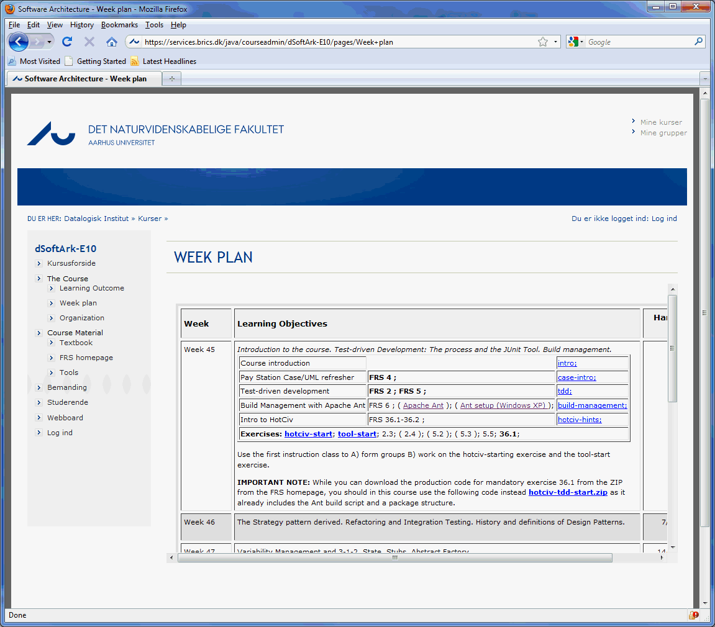
Website: dSoftArk
CourseAdmin based
Comments welcome
AU CS
Henrik Bærbak Christensen

Slide 14
Mandatory Project
AU CS
Henrik Bærbak Christensen

Slide 15
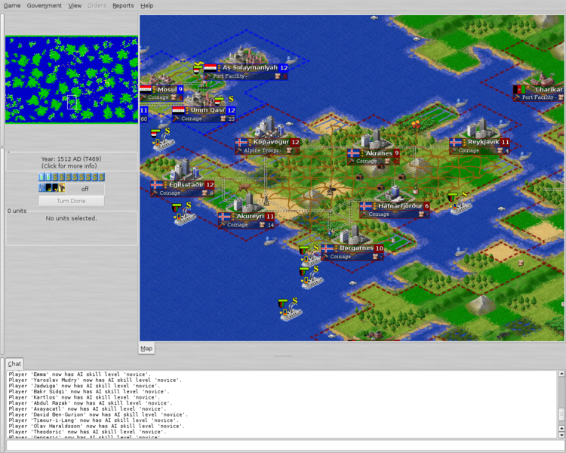
Mandatory project
HotCiv Framework
  Civilization game
Six exercises
  TDD
  Comp Design
  Patterns
  Frameworks
  Systematic Test
Like ‘real’ agile development
Code+Exercise on web
(Note: Image is not HotCiv ☺)
AU CS
Henrik Bærbak Christensen

Slide 16
Mandatory project
Functionality and architecture are orthogonal.
  The project’s focus is architectural
    Use compositional design techniques to support variants of game play!
    Actual rule behaviours are less interesting
    Keep focus on the architectural aspects!!!
  Thus
    Good: Missing functionality but correct compositional design
    Bad: All functionality but variants handle by large ‘if’s
AU CS
Henrik Bærbak Christensen

Slide 17
Mandatory Team Process
Process is important: Test-driven…
3 person group
  Do same-time, same-location work using three roles
    Programmer: has the keyboard, do programming
    Test list maintainer: update test list, review code, dream up new test cases, spot refactoring opportunities
    Recorder: Ensure TDD process is followed (rhythm, TDD principles, refactoring), stops work if process not followed, write down process steps and analysis for the report.
  Change roles every ½ hour!!!
2 person group
  One person is both test list maintainer + recorder
AU CS
Henrik Bærbak Christensen

Slide 18
Delivery schedule
Delivery at 23.59 after the lab with the TA
  So – do most of the work before the workshop, everything else is a ticket to disaster ☹
AU CS
Henrik Bærbak Christensen

Slide 19
Mandatory Exercise
Heavy on tools!
  Ant based
  Package structured, dual source tree
  Non-trivial sized code base
  I strongly advice using subversion for team work
  IDEs:
    Emacs/editor + shell will do (my book assumes only this)
    Eclipse better when doing refactorings, especially moving abstractions between packages and keeping subversion informed!
Morale: Get started right away!!!
AU CS
Henrik Bærbak Christensen

Slide 20
Mandatory Team Process
If group is forced to work different-location then
Each person does full TDD by himself/herself on selected aspects of the requirements
Meet to discuss experiences with the process; and ‘merge’ the contributions.
AU CS
Henrik Bærbak Christensen

Slide 21
The official secret
The mandatory exercise is designed to cover almost all heart-blood techniques in this course.
Additional exercises are basically ‘more of the same’
Morale: Deep work on the mandatory is better than surface work on all exercises…
AU CS
Henrik Bærbak Christensen

Slide 22
What we expect from each other
Lectures can be quite boring - can we avoid that?
I will try to
  make some short exercises during lectures…
  discuss with you (requires two for a discussion ☺)
  tell some war-stories from “the real life”
I expect you to
  attend because you find that you learn something
  if not:
stay away and spend your (and my) time better!
AU CS
Henrik Bærbak Christensen

Slide 23
2012 Initiatives
Reshuffled web-site – again again
Welcome to Emma ☺
  Vague quality measure of your test code...
AU CS
Henrik Bærbak Christensen

Slide 24
Exam
Exam form:
  18-20 minute preparation on a concrete exercise
    Typically “Analyse and refactor this code [...] using framework theory”, etc.
  15 min examination
    analyse the code fragment; sketch Java and UML; suggest improvements; use theory, terminology, techniques from the course; relate to other topics.
AU CS
Henrik Bærbak Christensen

Slide 25
Exam
Important requirement for passing the exam:
  Demonstrate operational knowledge !!!
    Analyse the code fragment correctly
    Suggest good design solutions
    Sketch solutions in correct Java and UML
  Analytical skill
    Know why your design is better than other designs
  Terminology skills
    Know the terminology
AU CS
Henrik Bærbak Christensen

Slide 26
Thus...
The purpose of the mandatory project is
  To read code, to read requirements
  To suggest architectural solutions
  To implement and code them
  To analyse benefits and liabilities correctly
So – investing time in the project is a very good preparation to the exam…
AU CS
Henrik Bærbak Christensen

